Slide 1
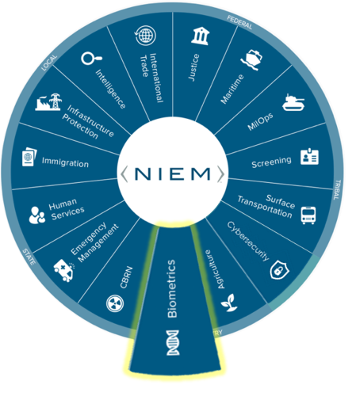
NBAC Annual Meeting
BIOMETRICS
DOMAIN UPDATES

Slide 2


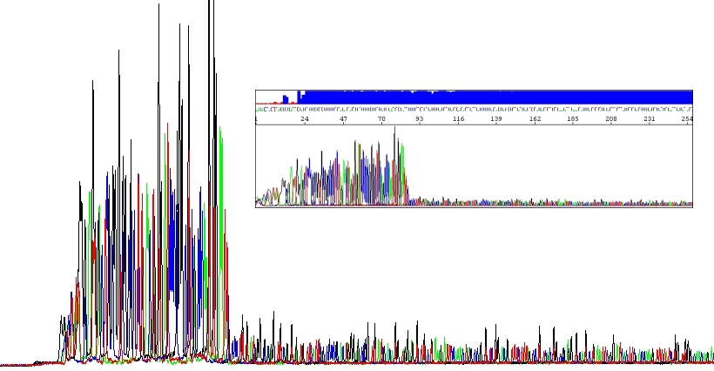
“Biometrics” Domain Update
Domain Steward & Stakeholders: (AD John M Boyd - Chair Biometrics Domain/DHS OBIM)
Mature the Domain:
The NIEM Biometric Domain (NBD) Team at OBIM led bi-weekly NIEM Biometric Domain Working Group (NBDWG) meetings where DNA SME’s, NIST, & the NBD Executive Committee (NBDEC – DHS, DoD, DOJ, & NIST) to expand DNA related attributes.
Additional DNA attributes were added to the NIEM 5.1 Biometrics Domain release.
2021 Highlights
Open-Source Project:
The NBD Team is working with the DNA Store Match Share team, on a DNA Open-Source Project to replace the 16-bit integer field with a 32-bit integer field by producing a new file format, .fsax. The need was identified in the HLT NBDWG meetings.
We stood up a GitHub Repository for this effort, which will enable peak heights to be expressed as the maximum of a 32-bit integer (2.14 billion).
2022 Objectives
We would like to know if there are any other agencies working on maturing the DNA standard.
Recommendations

Slide 3

“Biometrics” Domain Update
Domain Steward & Stakeholders: (AD John M Boyd - Chair Biometrics Domain/DHS OBIM)
We held NBDWG meetings for identification of voice related attributes to support OBIM’s Human Language Technology (HLT) initiative.
We performed a NIEM, NIST, and Open Language Interface for Voice Exploitation (OLIVE) Software standards gap analysis to as part of the NBDWG HLT effort. OLIVE is being utilized by OBIM in their HLT pilot.
This effort is to identify possible attributes for NIST & NIEM updates (5.2 release) to mature HLT in the NBD domain.
2021 Highlights
We would like to know if there are any other agencies working on voice as a biometric modality, so we gather broader use cases to factor into the NBDWG discussions.
2022 Objectives
The “way ahead” for the Biometrics Domain will be to advance the NIEM model for HLT/Voice & collaborate with NIEM on the NIEM Biometrics Domain 5.2 release.
Recommendations

Slide 4
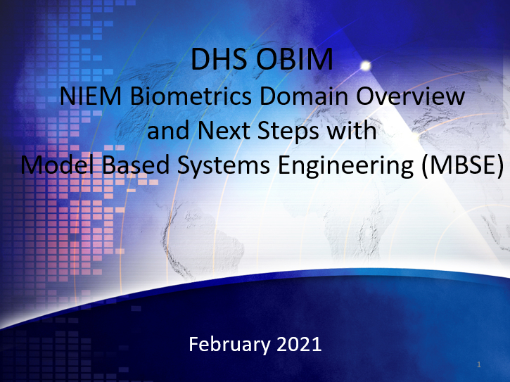
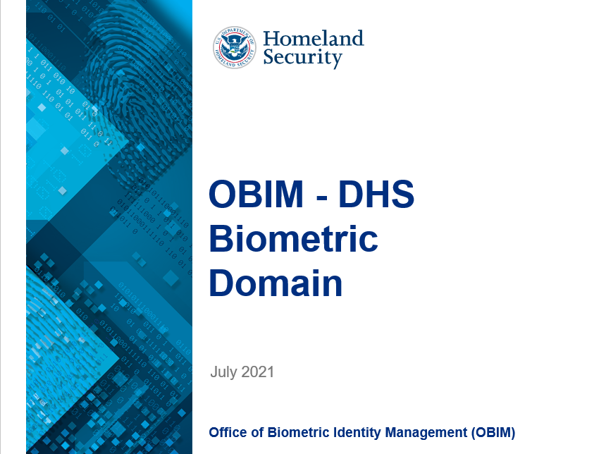
“Biometrics” Domain Update
We Promote NIEM!
Domain Steward & Stakeholders: (AD John M Boyd - Chair Biometrics Domain/DHS OBIM)
Activities for 2021 include, but are not limited to, the briefings which we provided to promote NIEM adoption for the below agencies and groups:
The DHS Office of the Chief Information Officer (OCIO) Chief Data Officer & team
The Data Stewardship Tactical Working Group (DSTWG) Immigration Technology Summit
DHS Management’s Mission Support & Management Domain (MSMD) briefing is scheduled
2021 Highlights
We support the NTAC & NBAC, Tiger Teams, and we review technical specifications related to NIEM, e.g. Metamodel Primer.
The NBD Team will continue to promote & support NIEM through briefings, outreach, NBDWG sessions, NBAC, NTAC, & Tiger Teams, Newsletters, and more.
The NBD Team will continue contributing to the NTAC as a member.
2022 Objectives
Please let us know if you have any feedback or recommendations.
Recommendations

Slide 5
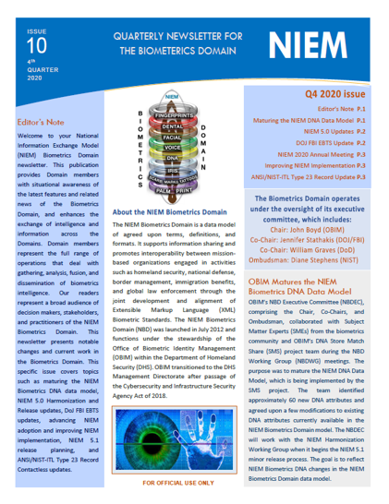
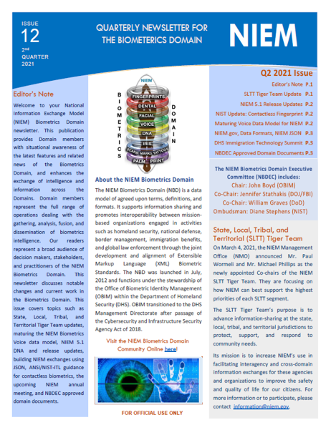
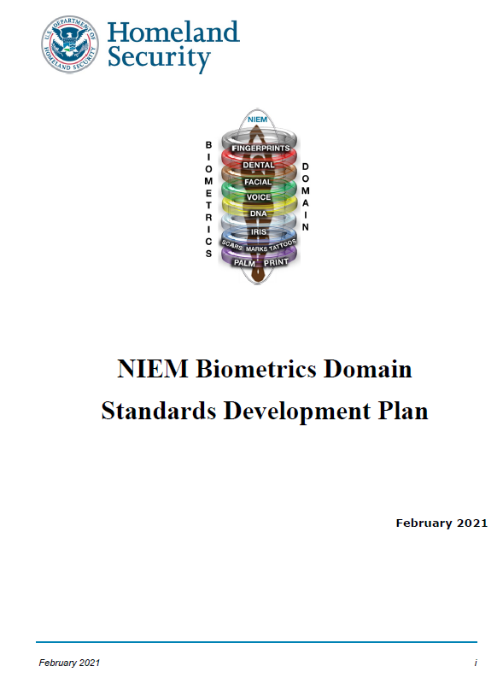
“Biometrics” Domain Update
Domain Steward & Stakeholders: (AD John M Boyd - Chair Biometrics Domain/DHS OBIM)
The NBD Team worked with the NIEM Management Office (NMO) to launch a NBD GitHub site to provide domain documentation to the NIEM community. https://niem.github.io/community/biometrics/
NBD Standards Development Plan
NBD Governance Process Plan
NBD Enterprise - Level Data Standards Execution Plan
NBD Domain Management Plan
How to Guide for Creating NIEM Biometric Exchanges
2021 Highlights
We provide quarterly biometrics newsletters for NBD Members.
We maintain & update the member list.
The NBD will continue the outreach to the biometrics community through development of domain documentation and newsletters.
The NBD Team will keep the GitHub site up to date with new information, activities, and updates to keep the community posted.
2022 Objectives
Please let us know if anyone is interested in NBD membership. We can be contacted via: OBIMFuturesIdentityNIEM@obim.dhs.gov
We would appreciate hearing success stories from other domains for engaging members.
Recommendations

